Slide 1
Automatic Attendance System
Amin Yousefian
Triza Kiilu
Shreya Mahajan
Yesha Shah

Slide 2
Overview
The project aims to make taking attendance in class considerably simpler than the already used traditional methods, such as roll calls to determine whether or not students are present.
The classroom automated attendance system eliminates the major administrative burden of taking manual attendance saving teachers time and easily accessible reports direct to their emails to keep records for future reference.

Slide 3
Data Collection
A camera is used to capture images of the attendees, and OpenCV is used to detect and recognize their faces. The attendance data is automatically recorded based on the faces detected. This method is more accurate and efficient than manual data entry or ID card scanning.

Slide 4
Data Cleaning and Preparation
Image resizing and cropping: The images of the attendees should be resized and cropped to ensure that they are all of the same size and format.
Face detection: OpenCV can be used to detect the faces in the images. This is an important step since it is the faces that will be used for recognition.
Feature extraction: OpenCV can be used to extract features from the faces, such as the location of the eyes, nose, and mouth. These features can then be used to compare and match faces.
Labeling: Finally, the images of the attendees should be labeled with their names or IDs to create a training dataset for the model.

Slide 5
Model Building
The first step in model building is to create a training dataset by labeling the images of the attendees with their names or IDs. This dataset is then used to train a machine-learning model that can recognize and match the faces of the attendees.
Open CV - A machine learning and computer vision software library, its main purpose is to speed up the incorporation of machine perception into consumer goods and provides a simple interface to capture live streams with a camera.
Open AI - Built a chatbot that could be able to communicate with parents when their child is absent from school and get a response that will be stored in an SQL database. This comes in handy when a teacher does not have to call a parent directly.

Slide 6
Model Deployment
Hardware setup: The system needs to be set up with the required hardware, such as cameras to capture attendance data.
Data processing: The attendance data captured by the system is processed by the model to recognize and match faces.
Updating the database: The attendance data is updated in real-time in the database, and reports can be generated based on the attendance data.
Maintenance and updates: The system needs to be regularly maintained and updated to ensure that it continues to function properly and that the model's accuracy is maintained.

Slide 7
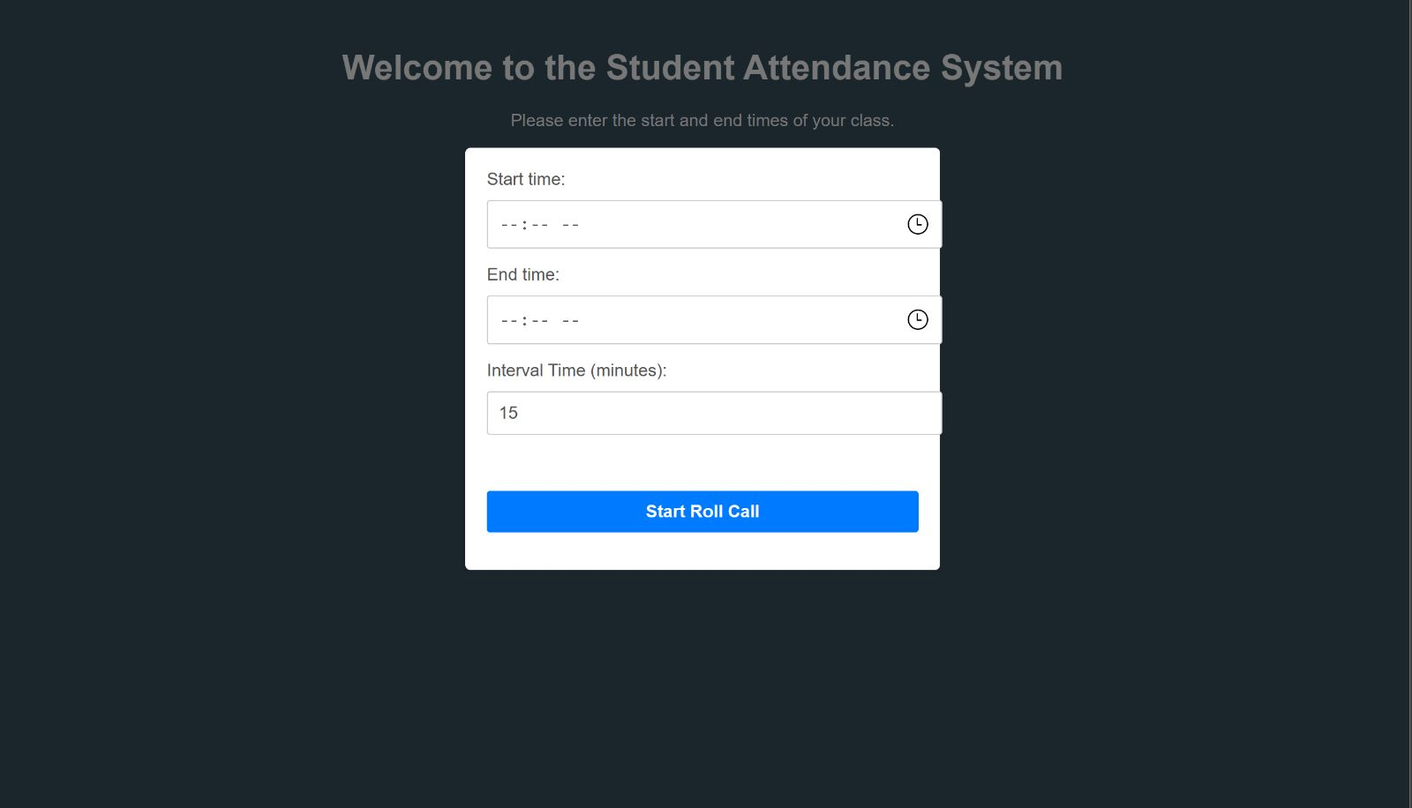
User Interface

Slide 8
Conclusion
The process of building an automatic attendance system using OpenCV involves several steps, including data collection, data cleaning and preparation, model building.
Model building involves training a machine learning model to recognize and match the faces of the attendees.
An automatic attendance system using OpenCV can provide a more accurate, efficient, and convenient way to track attendance.

